Slide 1
Classification of Erythemato-squamous Diseases
Project-Group 4:
Brendon Hahm
Nithish Kanna
Yueyan Li

Slide 2
Introduction and Considerations
Erythemato-squamous diseases (ESD) are a group of dermatological diseases that are uniquely difficult to diagnose due to their many overlapping similarities in symptoms. This is issue makes it hard for dermatologists to diagnose patients based off of symptoms
Given the similarities of their symptoms, our model has to make nuanced and informed splits in data to help differentially diagnosis that even a well trained eye may have difficulties with
A perfect case for classification and tree models in particular
Data type of all features are ordinal except age
Symptoms are largely subjective phenomena that are reported, either phenomenologically by the patient or intuitively by the medical worker
While there may be subjective bias in the data entry, errors are likely random which should still allow us to model the data well
This makes the model more of a tool for the physician than a full and complete diagnostic tool. The model should be used in conjunction with medical expertise

Slide 3
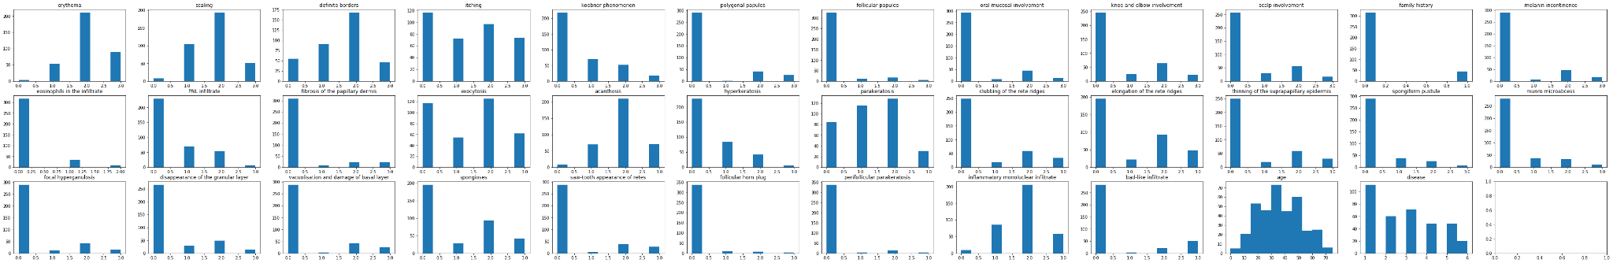
Data preprocessing and visualizations
The data came relatively clean and ready for modeling. Given that all of our data is ordinal and has six class labels, it is difficult to show too many visualizations.
Distribution of features

Slide 4
Decision Tree and Random Forest Classification
The choice for a tree based model was primarily based on the intuitive nature of sequentially finding the features that make the best splits
Helpful for analysis sake and allows us to find the most significant features
The tree algorithm also has inherent feature selection properties that make it unique for the problem where features are likely highly correlated (*When features are highly correlated, a decision tree approach is much more robust to collinearity than other models)
However, with such high dimensionality in the dataset, a random forest model will help us model the data and avoid the tendency of single decision tree models to overfit the data
We ran both models to investigate if the benefits of random
forest would apply to our problem

Slide 5
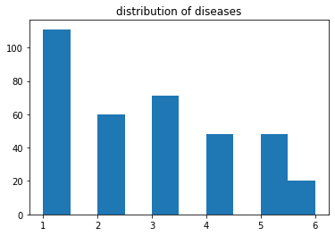
Repeated Stratified K-Fold
We noted an imbalanced dataset when examining the distribution of diseases
This leads us to choose repeated Stratified K-Fold for the following properties:
Robustness to imbalanced datasets
Repetition allows us to be more confident in the generality of the folds and makes our cross validation less likely to be the result of an unfortunate split in folds
10 Folds were chosen for both decision tree and random forest model

Slide 6
Hyperparameter Optimization
Decision Tree
Grid search was used since we are only interested in searching the max_depth hyperparameter
Smaller hyperparameter space and time complexity of decision trees allow us to feasibly perform an exhaustive search of the hyperparameter space
Random Forest
Randomized Search was used since we are interested in both max_depth and n_estimators since both hyperparameters are crucial to the performance of the tree
The many possible values for both lead to a much larger hyperparameter space we want to search so a randomized approach would be more feasible

Slide 7
Results
Decision Tree had a testing accuracy of 0.95 with a max depth of 8 while the
Random Forest model had a testing accuracy of 0.98 with a max depth of 8 and number of trees of 69.
We can see the aforementioned benefits of random forest over decision tree help perform better in the classification of the diseases

Slide 8
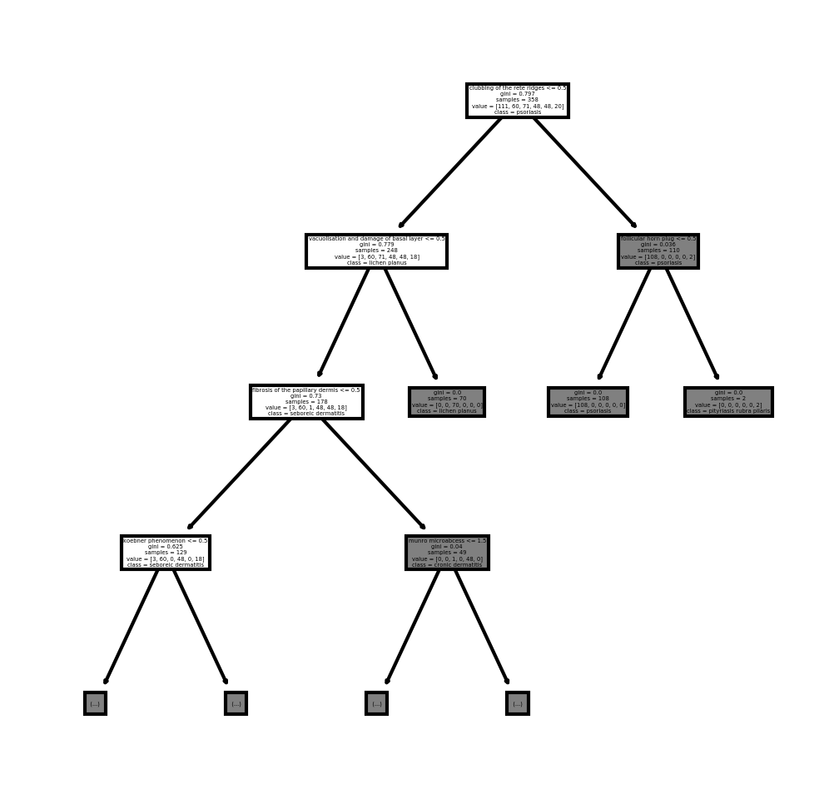
Decision Tree Model Results
Best splitting features:
Clubbing of the rete ridges <= .5
Gini: 0.797
Class: psoriasis
Vacuolisation and damage of basal layer <= .5
Gini: 0.779
Class: Lichen planus
Follicular horn plug <= .5
Gini: 0.036
Class: psoriasis

Slide 9
Conclusion
The subjective nature of the data entry did not seem to exhibit any non-random bias to the modeling
Still able to achieve > .98 accuracy with random forest model
While a decision tree was quite accurate, the medical and severe nature of the problem required a much more accurate model where random forest helped
High dimensionality of data and relative robustness to overfitting are likely why random forest performed better than the decision tree
Decision tree has interpretability benefit by observing best discriminating features

Slide 10
References
G. Demiroz, H. A. Govenir, and N. Ilter, "Learning Differential Diagnosis of Eryhemato-Squamous Diseases using Voting Feature Intervals", Aritificial Intelligence in Medicine
[Web Link]
Papers That Cite This Data Set1:
Vassilis Athitsos and Stan Sclaroff. Boosting Nearest Neighbor Classifiers for Multiclass Recognition. Boston University Computer Science Tech. Report No, 2004-006. 2004. [View Context].
Gisele L. Pappa and Alex Alves Freitas and Celso A A Kaestner. Attribute Selection with a Multi-objective Genetic Algorithm. SBIA. 2002. [View Context].
Perry Moerland. Mixtures of latent variable models for density estimation and classification. E S E A R C H R E P R O R T I D I A P D a l l e M o l l e I n s t i t u t e f o r Pe r cep t ua l A r t i f i c i a l Intelligence . [View Context].
H. Altay Guvenir. A Classification Learning Algorithm Robust to Irrelevant Features. Bilkent University, Department of Computer Engineering and Information Science. [View Context].
M. V. Fidelis and Heitor S. Lopes and Alex Alves Freitas. Discovering Comprehensible Classification Rules with a Genetic Algorithm. UEPG, CPD CEFET-PR, CPGEI PUC-PR, PPGIA Praa Santos Andrade, s/n Av. Sete de Setembro. [View Context].
Rafael S. Parpinelli and Heitor S. Lopes and Alex Alves Freitas. PART FOUR: ANT COLONY OPTIMIZATION AND IMMUNE SYSTEMS Chapter X An Ant Colony Algorithm for Classification Rule Discovery. CEFET-PR, Curitiba. [View Context].
Rafael S. Parpinelli and Heitor S. Lopes and Alex Alves Freitas. An Ant Colony Based System for Data Mining: Applications to Medical Data. CEFET-PR, CPGEI Av. Sete de Setembro, 3165. [View Context].
Gisele L. Pappa and Alex Alves Freitas and Celso A A Kaestner. AMultiobjective Genetic Algorithm for Attribute Selection. Computing Laboratory Pontificia Universidade Catolica do Parana University of Kent at Canterbury. [View Context].

